Slide 1
A fusion of jewelry and hair accessories,
Studlees Charm Lockers are
poised to disrupt the fashion industry.
© 2022 Studlees – All Rights Reserved. Patent Pending

Slide 2
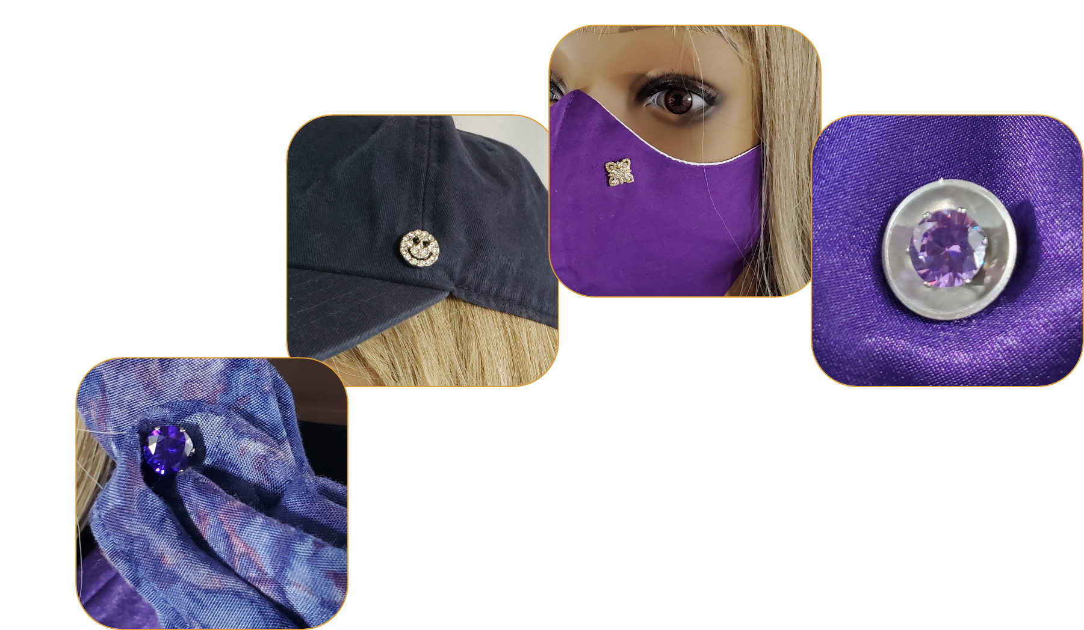
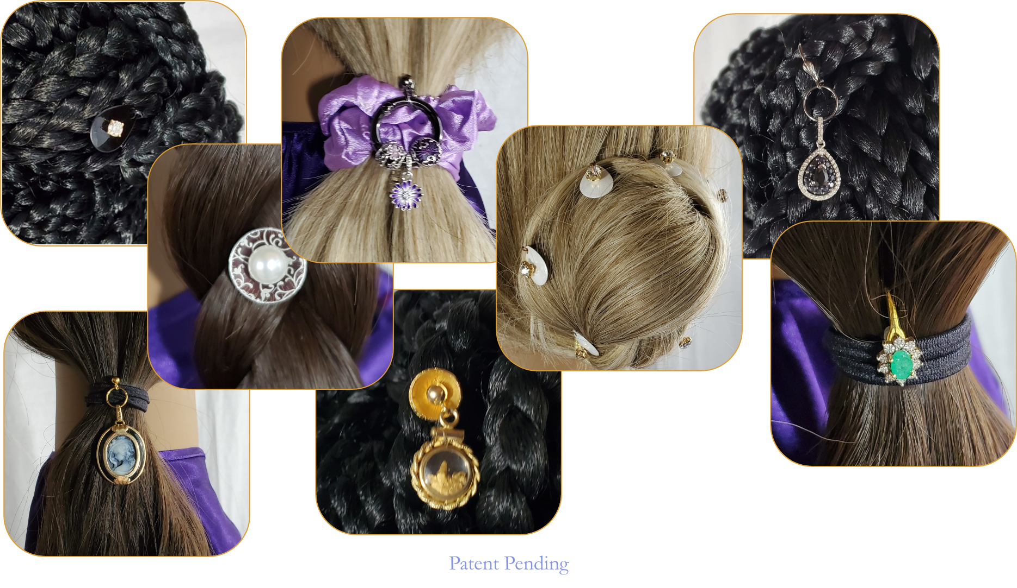
Studlees Charm Lockers
New jewelry adapters that secure earrings, pendants, and other charms to hair and fabric
Easy-to-use components that work together or separately to showcase multiple sets or a single charm
Reusable and makes existing jewelry collections multifunctional
Items can branded and sold with new jewelry to make them transformable
Elevates a jewelry collection above the shoulders for video calls or selfies
The Anchor
The Float
The Drop
The Key
The Strand
…wear your jewelry anywhere!
© 2022 Studlees – All Rights Reserved. Patent Pending

Slide 3
Inventor/Owner
Innovations Program Manager
Throughout her career, Dylan has worked with all levels of management to produce world-class technology solutions using cutting-edge technologies. A senior manager with a history of driving results out of chaos and leading by example, Dylan has won awards and honors for her work in the IT industry.
Over 25 years of experience managing customer-centric requirements and innovative development teams to deliver digital commerce and business-critical applications.
Led multiple cross-functional teams with hundreds of stakeholders with budgets of over $20 million annually
Focus has been on innovative experiences and strategic foundational implementations
Employers and client list includes small businesses, Fortune 500 companies, government agencies, non-profits, and entrepreneurships.
Dylan Rodrigues
© 2022 Studlees – All Rights Reserved. Patent Pending

Slide 4
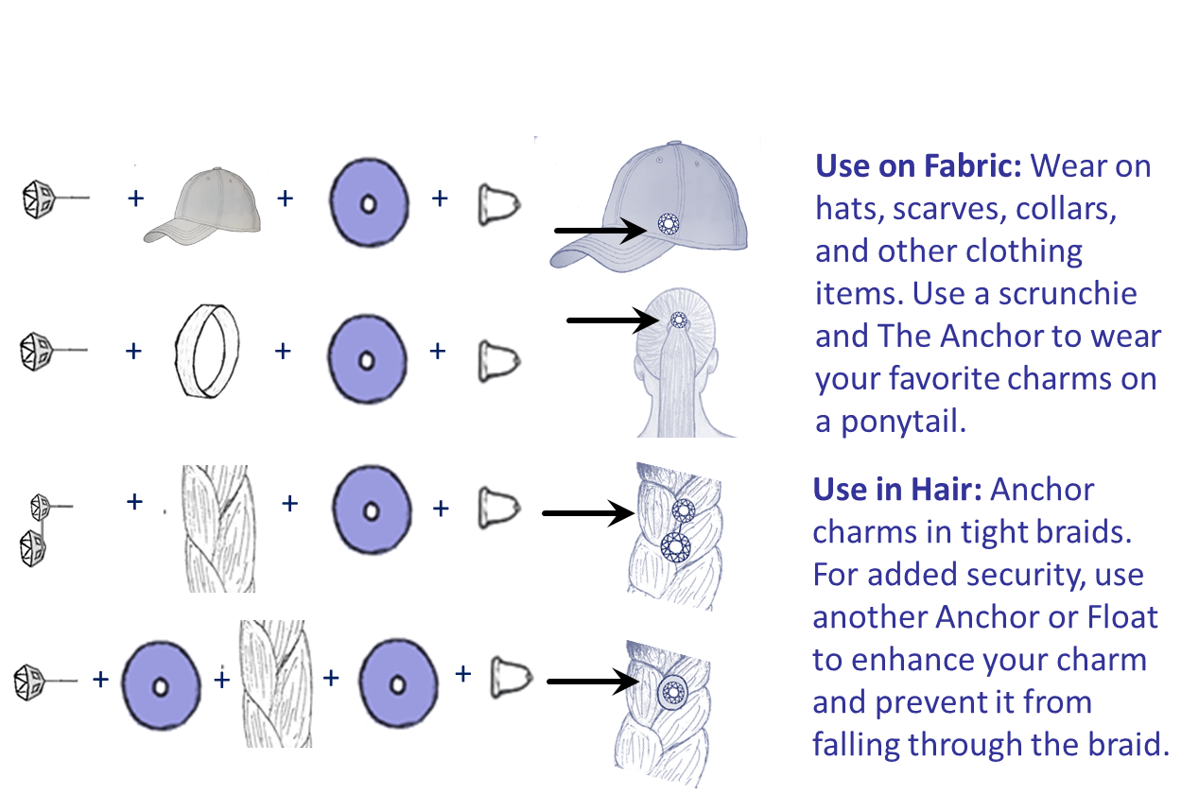
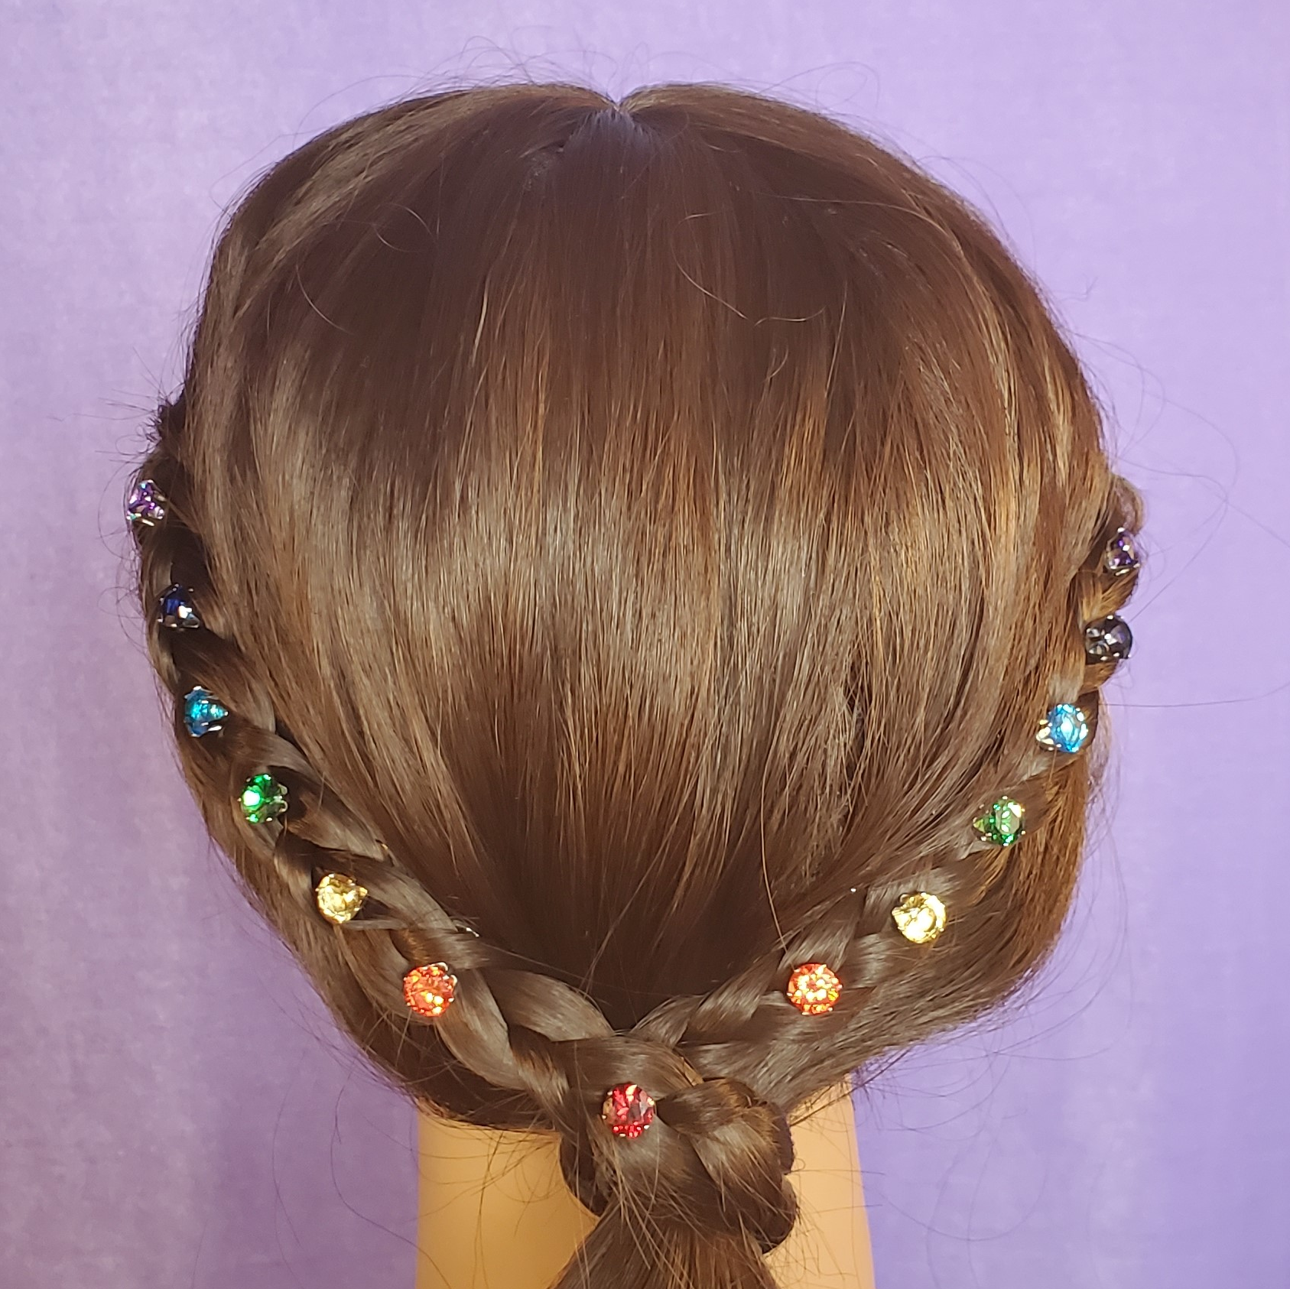
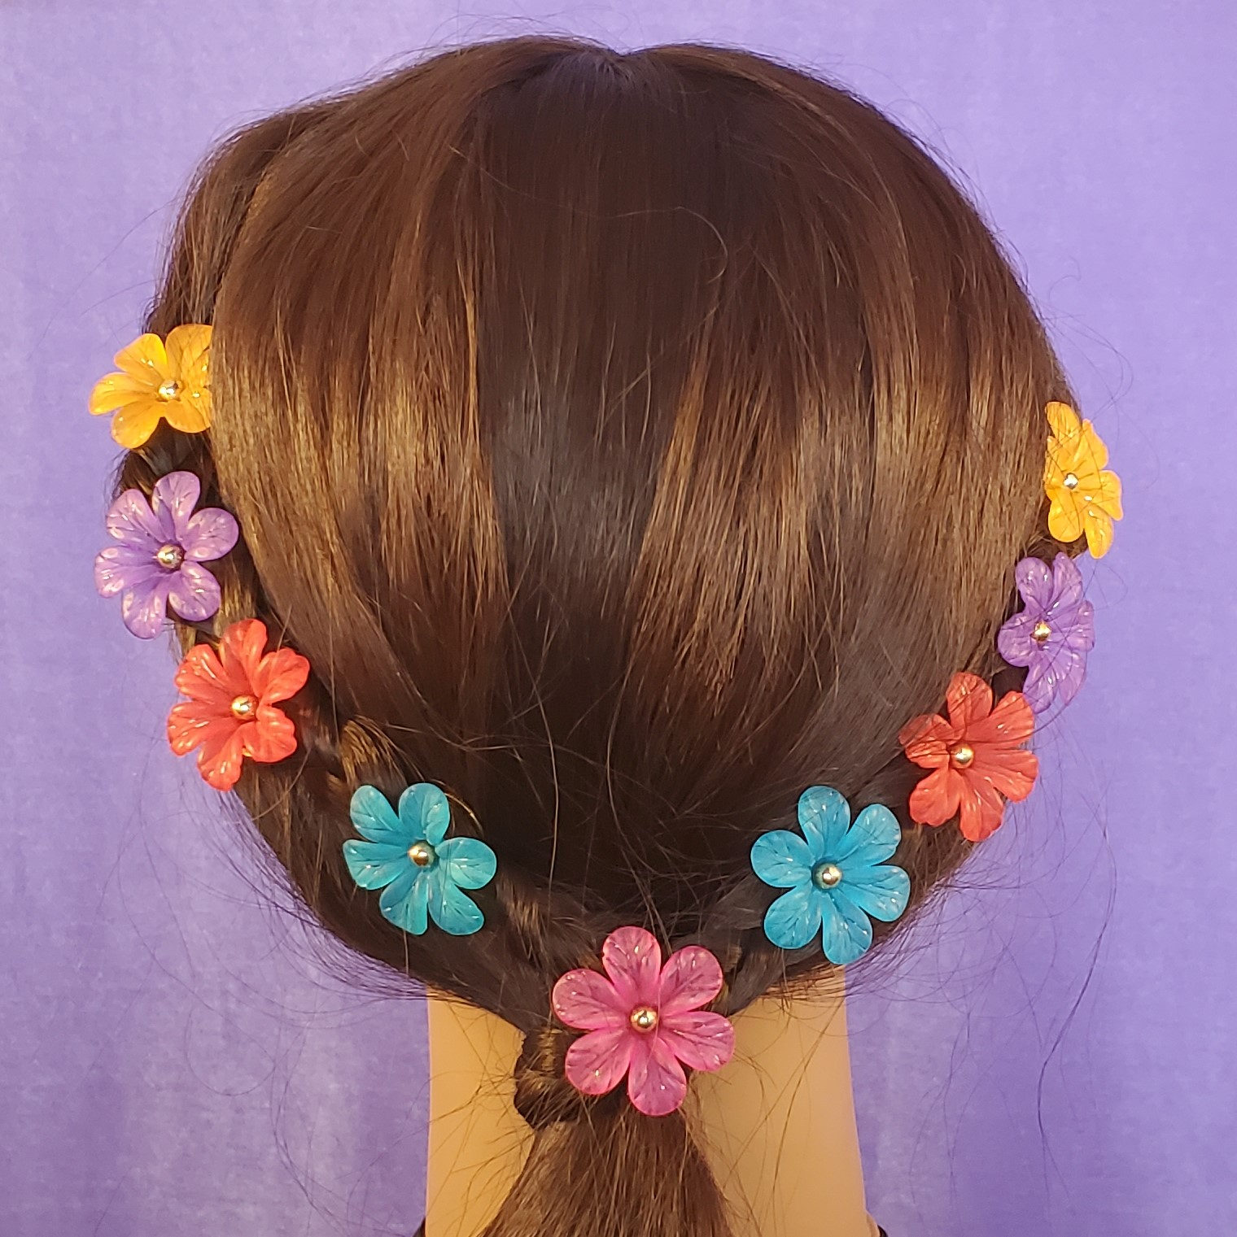
Works with all types of earrings
Dual use as platform and anchor
Can be imprinted with logo for branding opportunities
The Anchor – Ways to Wear
© 2022 Studlees – All Rights Reserved. Patent Pending

Slide 5
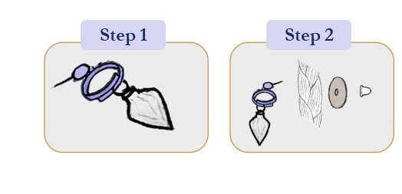
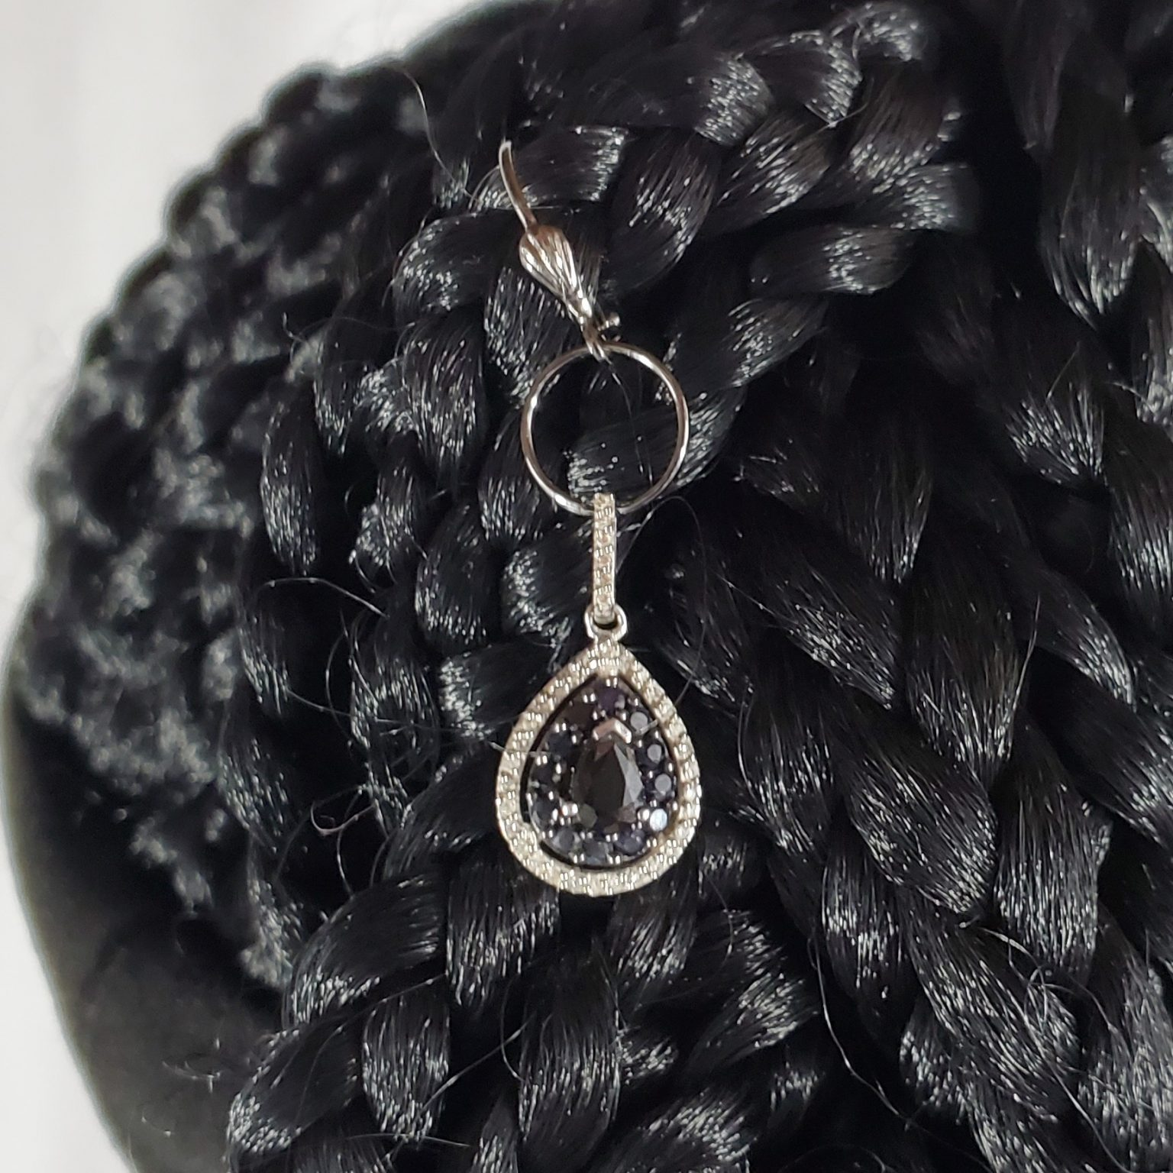
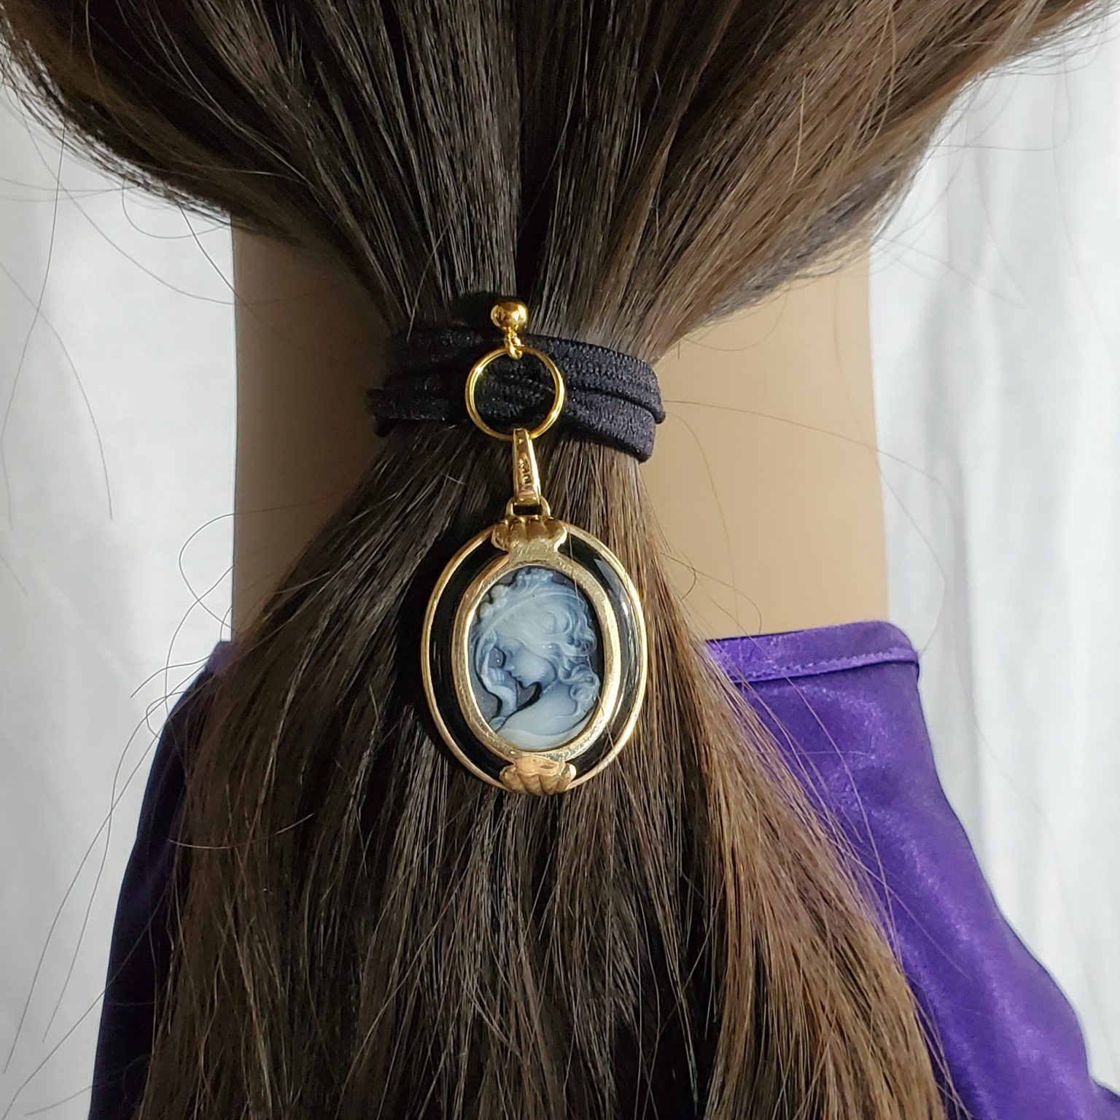
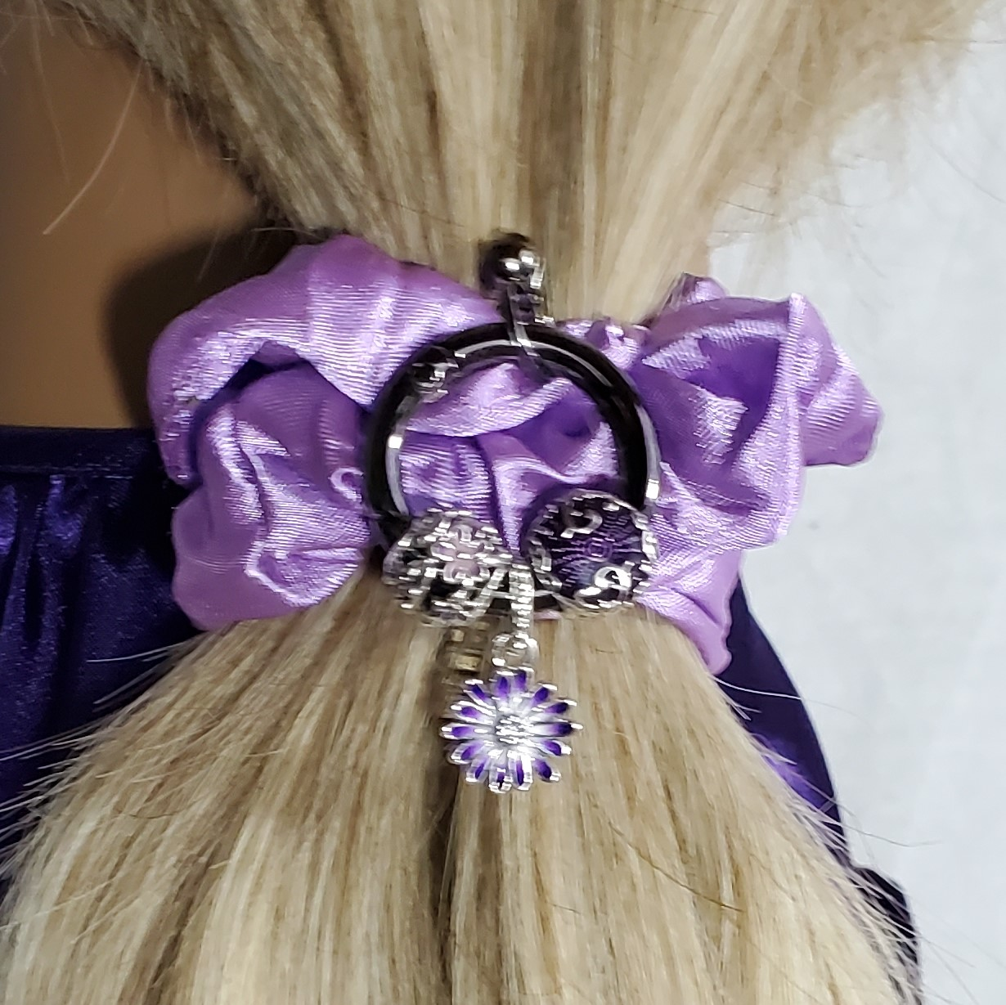
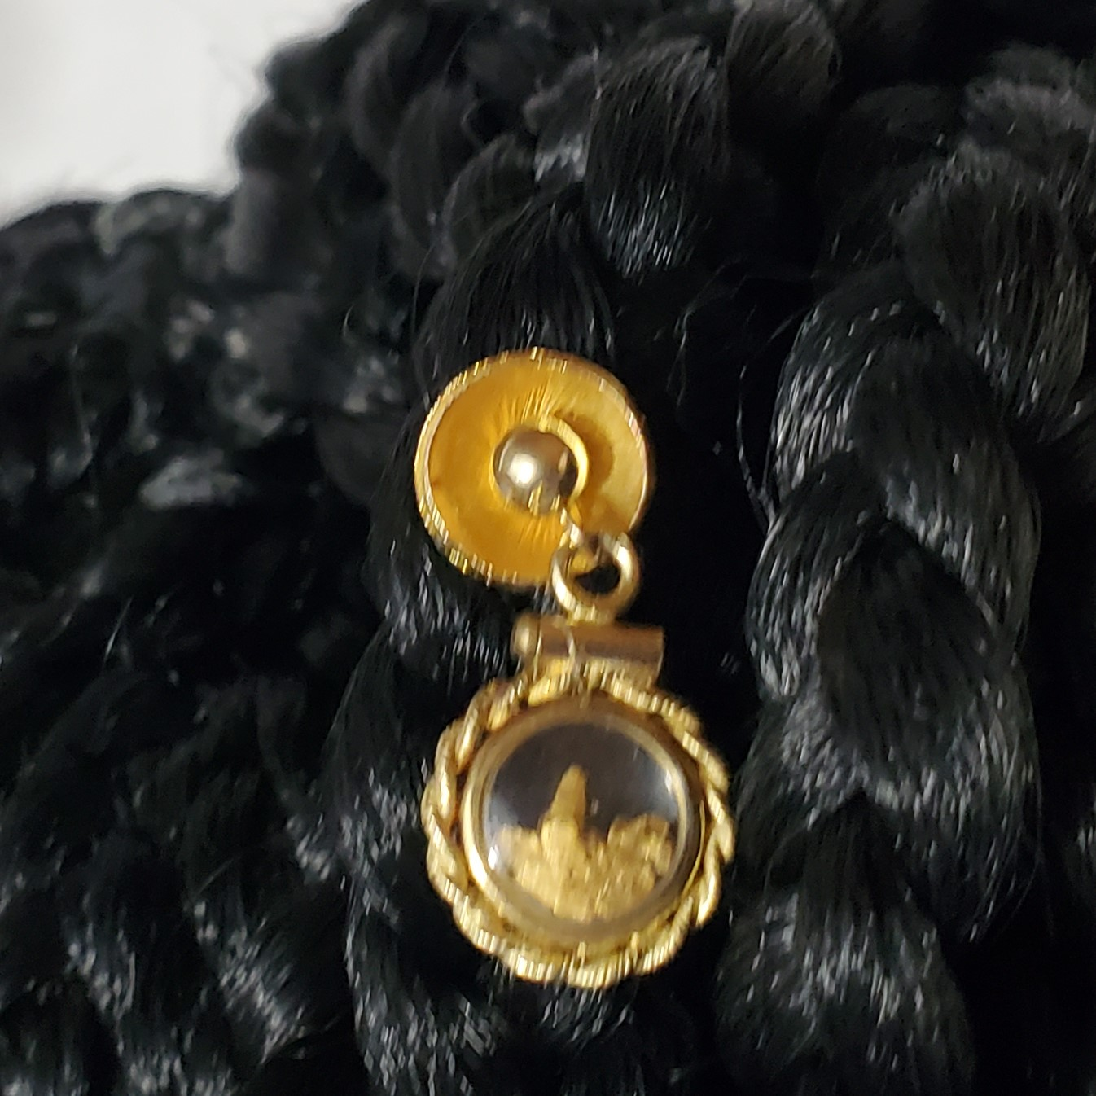
The Key – Ways to Wear
An Adapter for Pendants, Charms and Beads
Connects with other Charm Lockers
Use with Pandora® Charms and European Beads
Use with The Key for Pendants and Charms
© 2022 Studlees – All Rights Reserved. Patent Pending

Slide 6
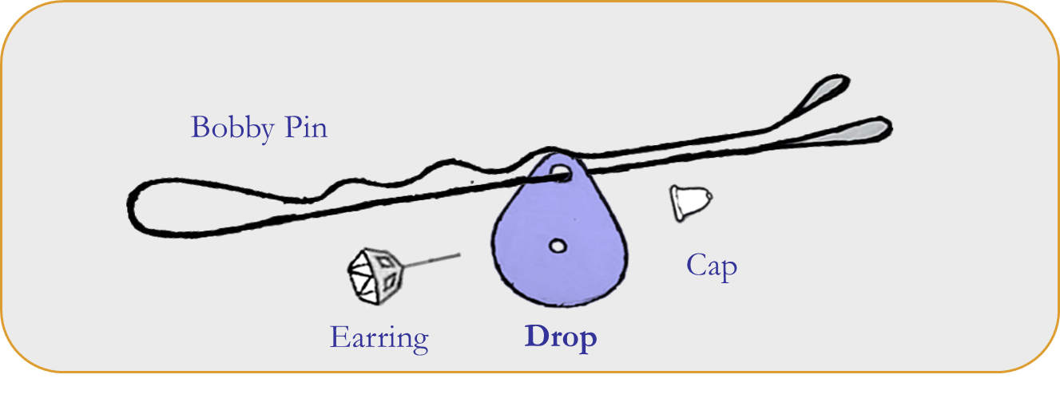
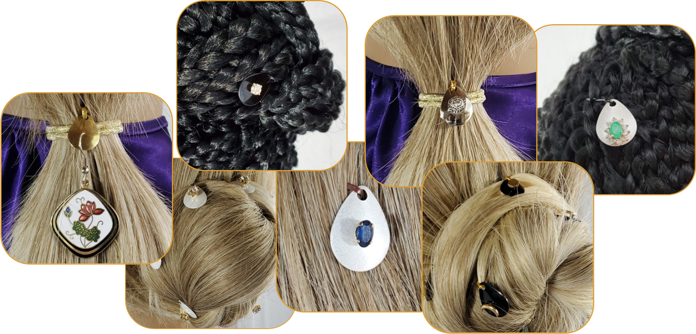
The Drop – Ways to Wear
Combined Anchor and Float Adapter for Hair Accessories
Connects with other Charm Lockers
Many finishes and several sizes
Use with The Key for Pendants and Charms
© 2022 Studlees – All Rights Reserved. Patent Pending

Slide 7
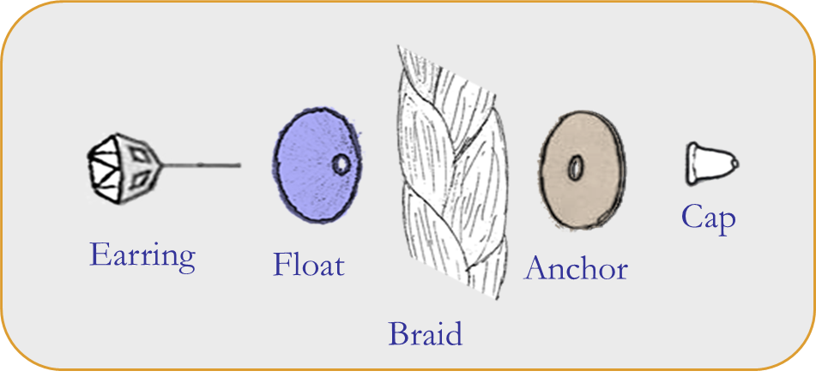
The Float – Ways to Wear
Lifts Charms Away from Hair and Fabric
Connects with other Charm Lockers
Enhances Smaller Charms
Use with The Key for Pendants and Charms
© 2022 Studlees – All Rights Reserved. Patent Pending

Slide 8
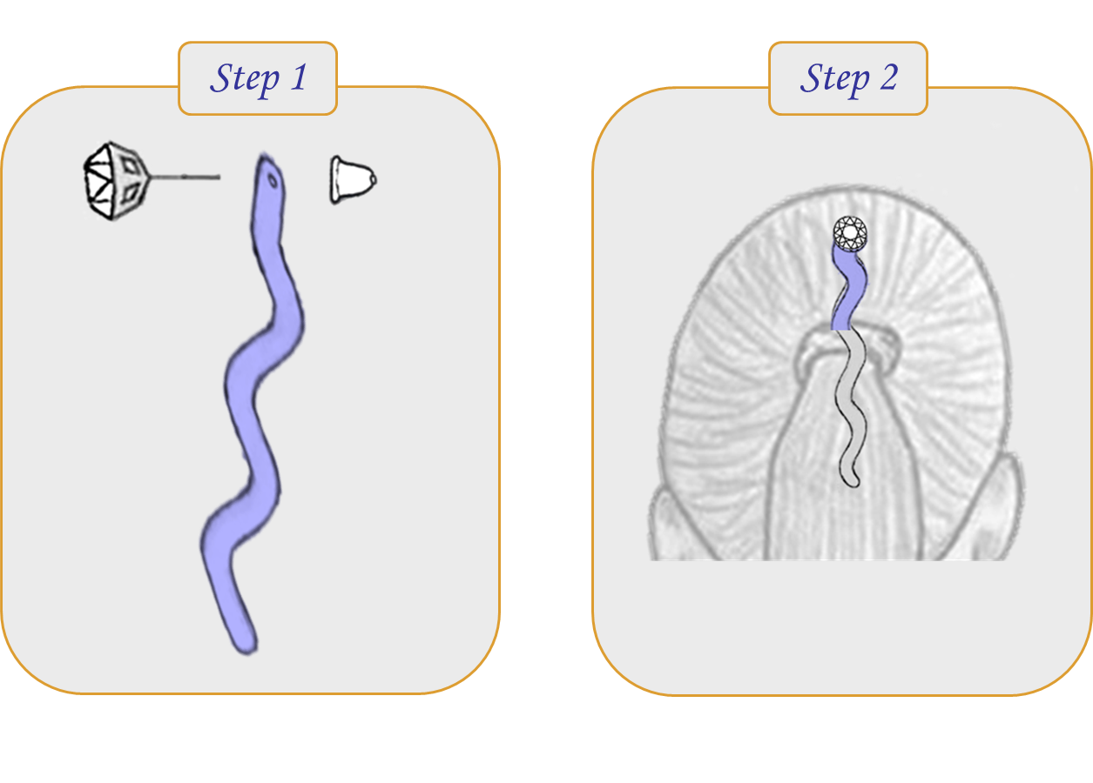
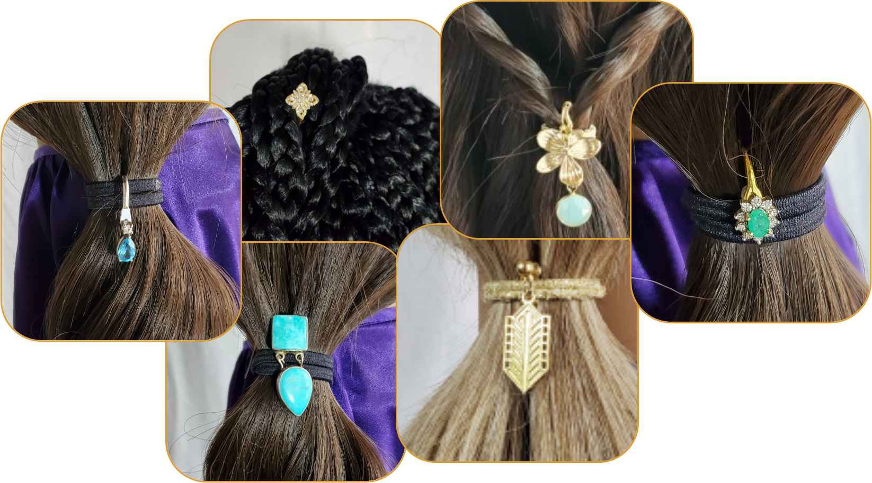
The Strand – Ways to Wear
Anchors charms in bound hair
Connects with other Charm Lockers
Sizes to support different hair types
Use with The Key for Pendants and Charms
© 2022 Studlees – All Rights Reserved. Patent Pending

Slide 9
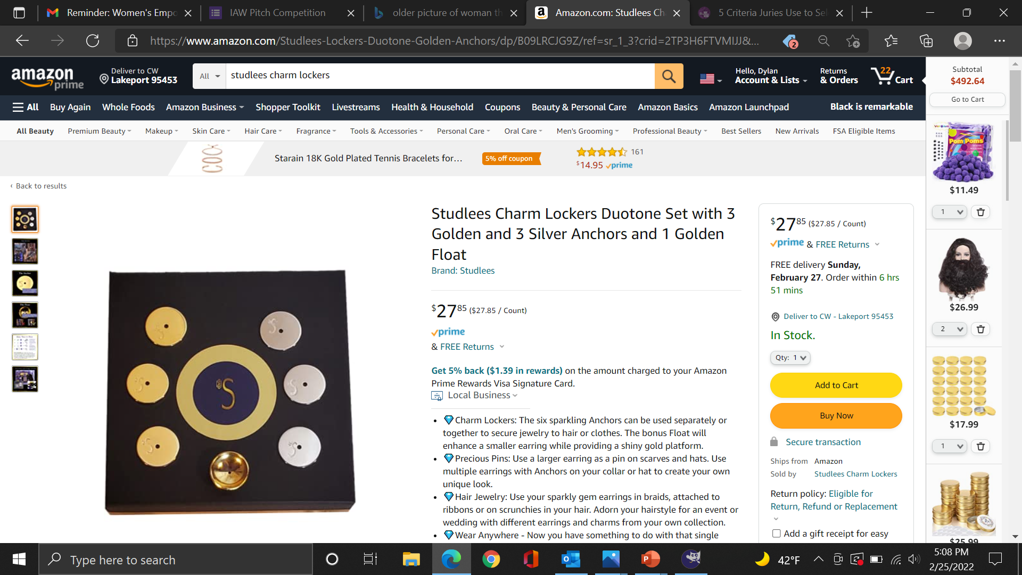
Patent Pending
Trademarks Pending
Initial Branding and Packaging
Available on Amazon Prime
Website Up and Google Ready
Samples and Products are Packaged
Soft Launch – No Marketing/Press
Current State
© 2022 Studlees – All Rights Reserved. Patent Pending

Slide 10
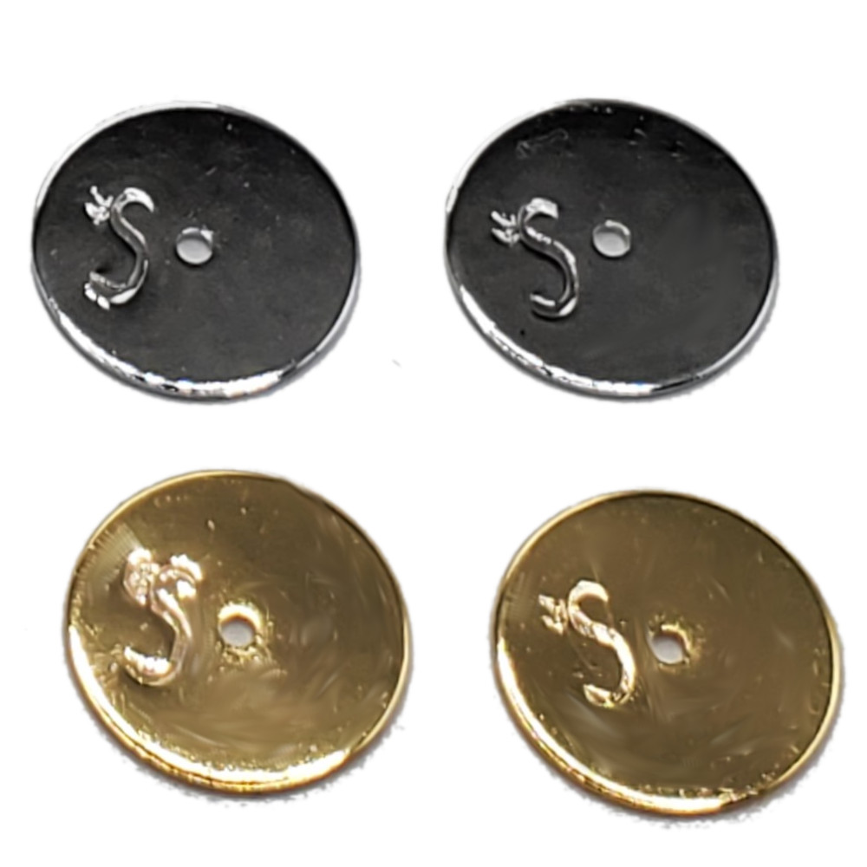
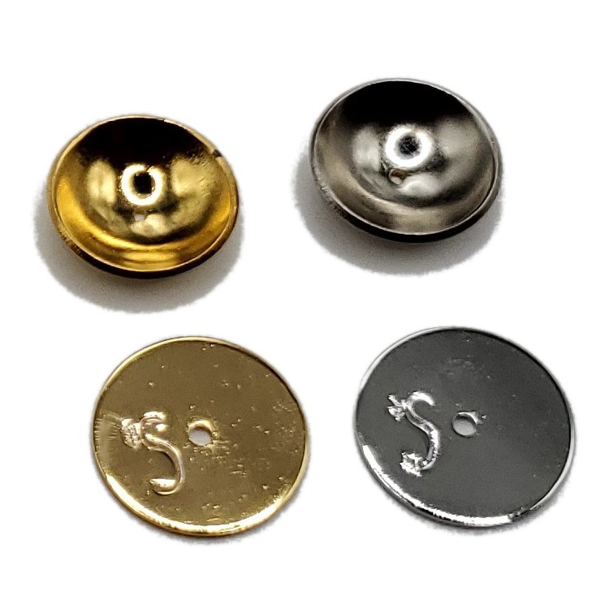
What’s Next - Funding
Marketing and PR Campaign
Licensing Offers and Agreements
Manufacturing Optimization
Sponsorships and Partnerships
© 2022 Studlees – All Rights Reserved. Patent Pending

Slide 11
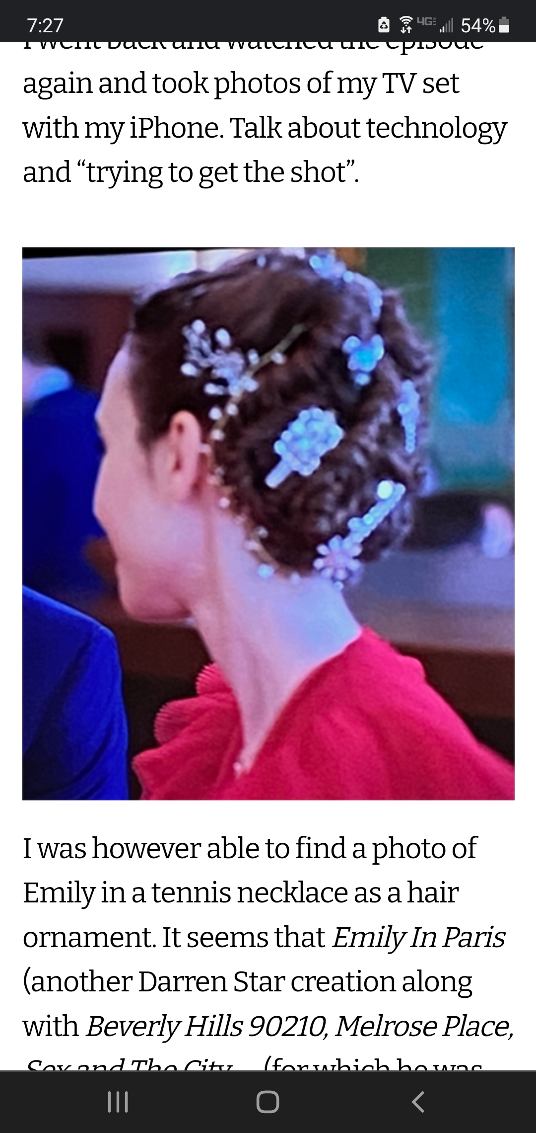
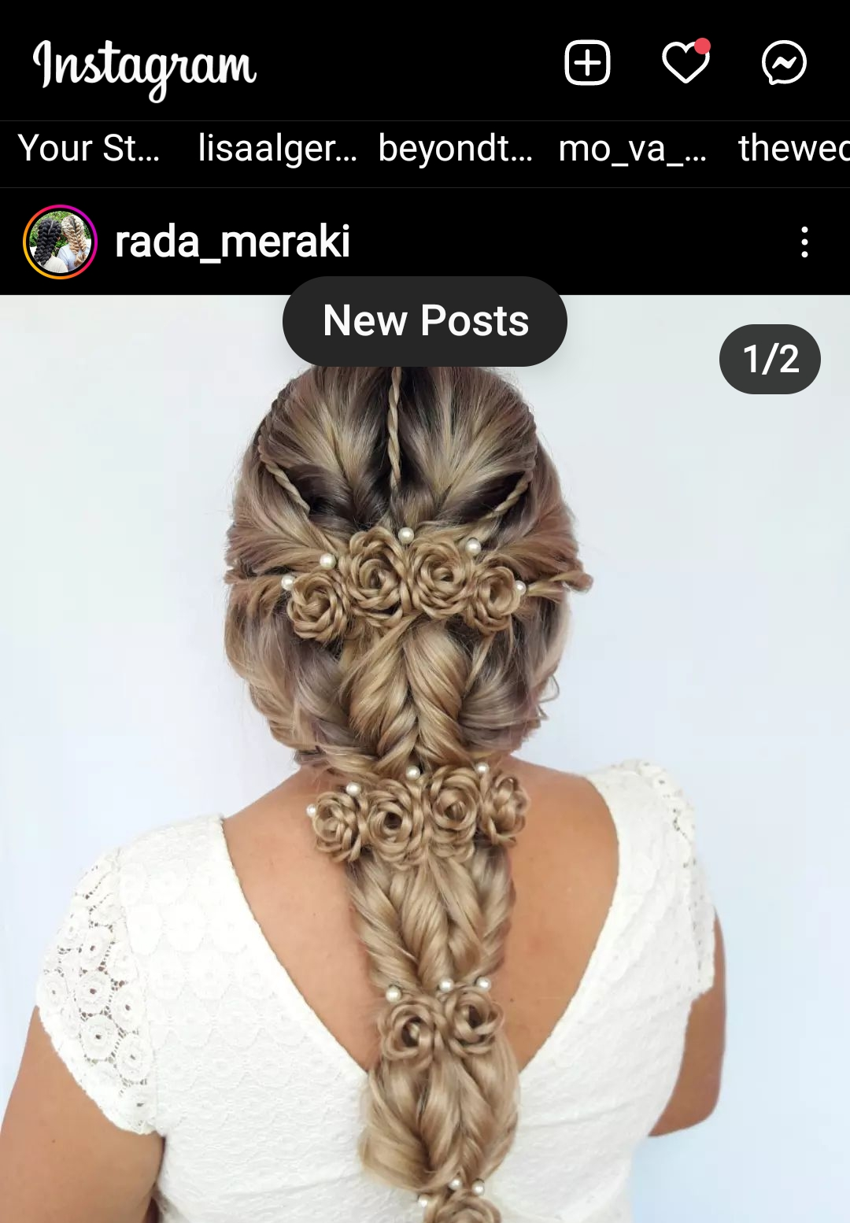
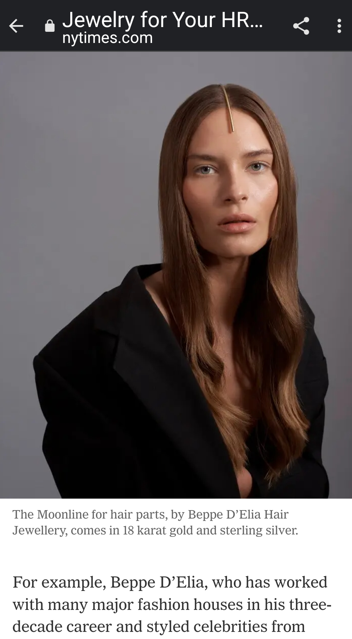
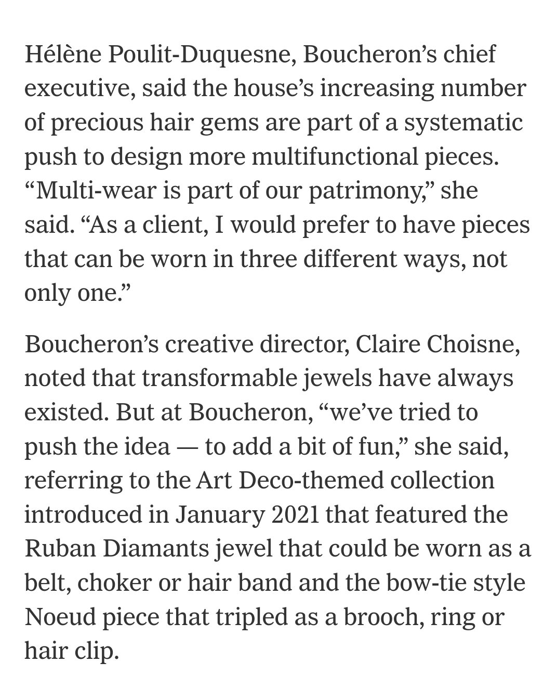
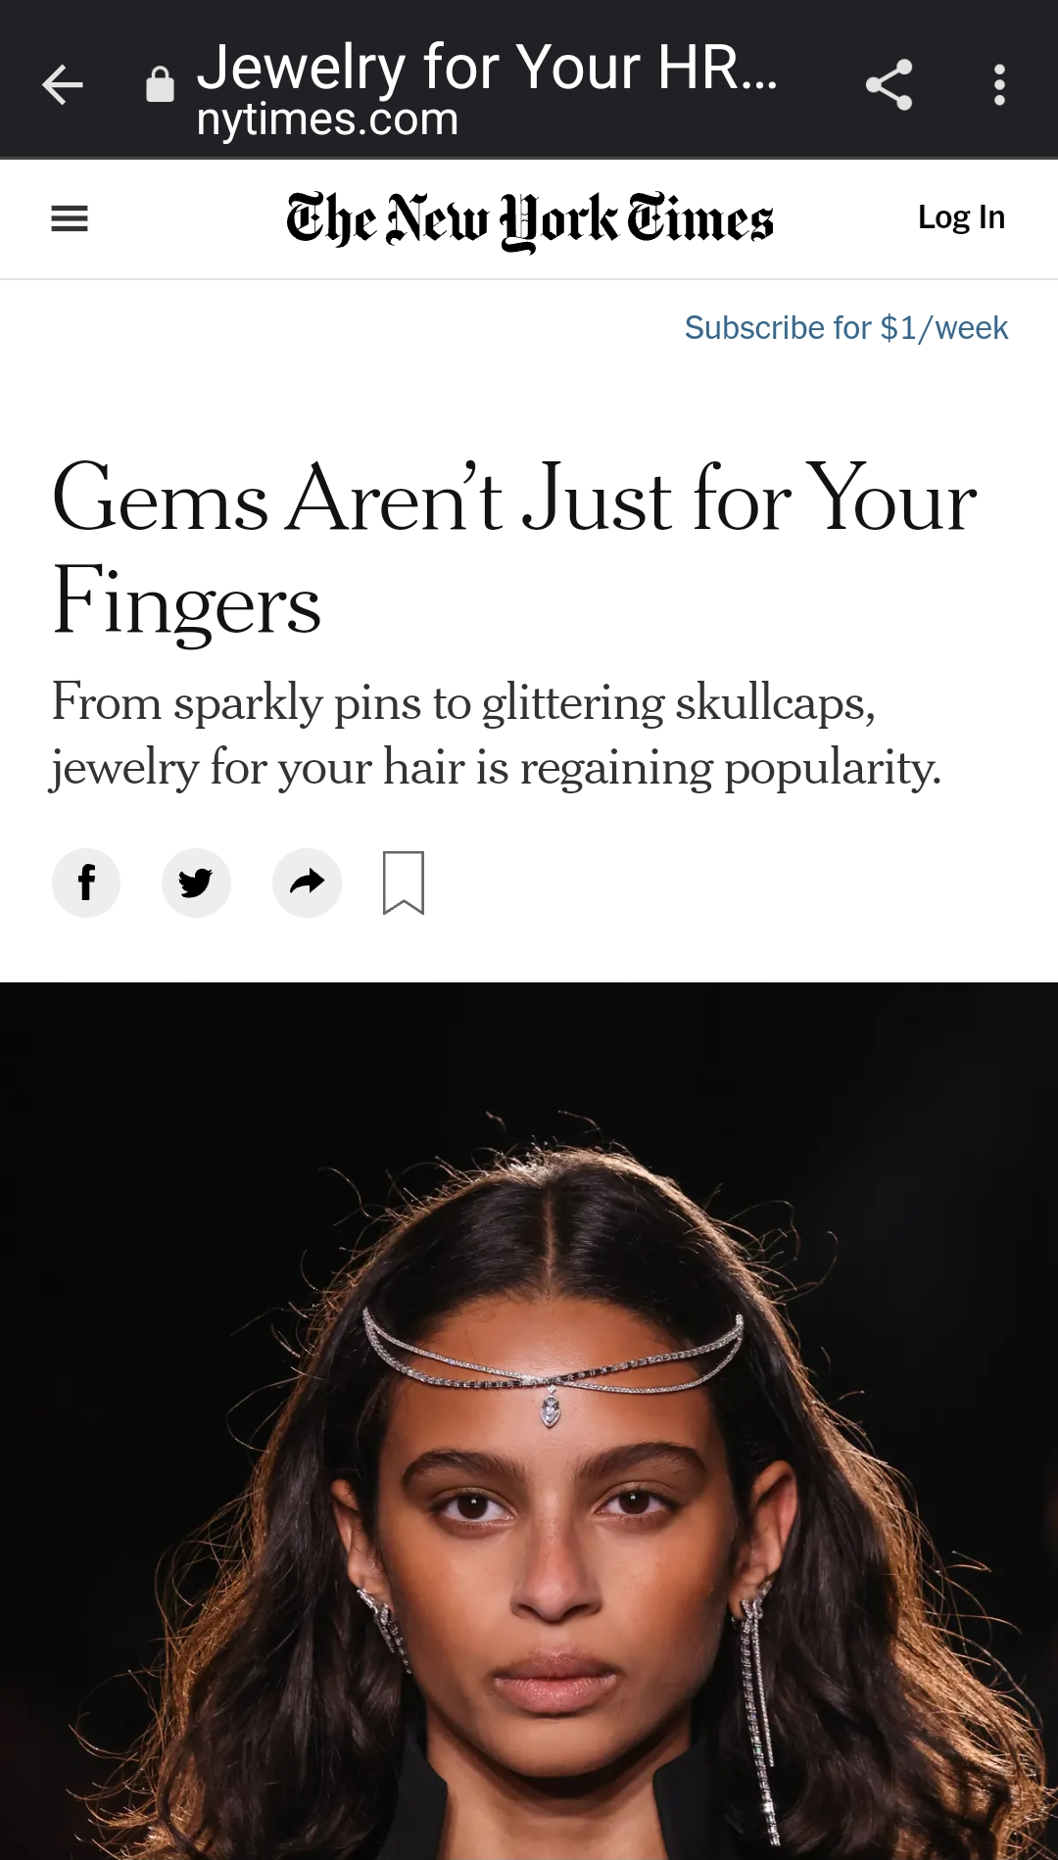
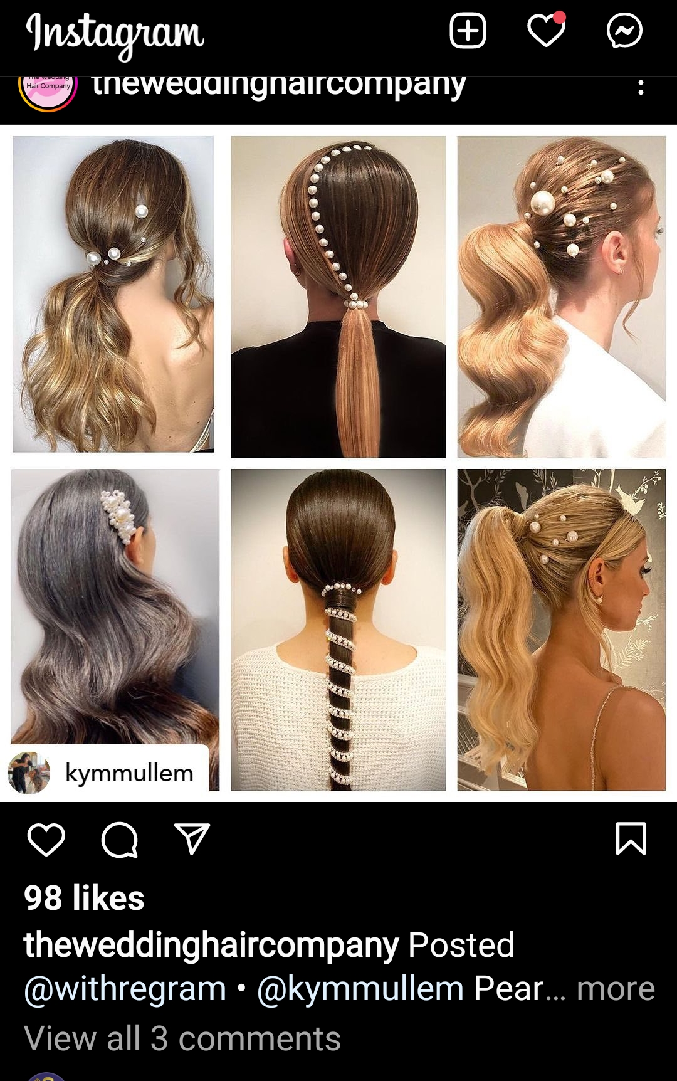
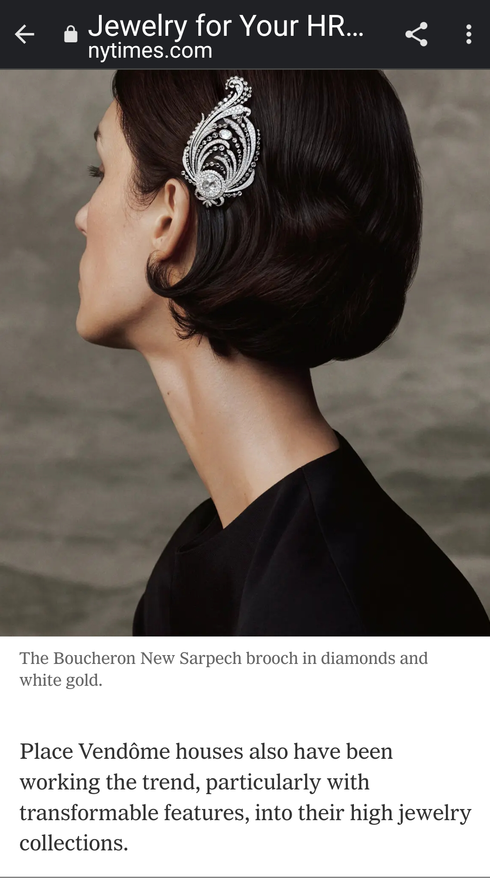
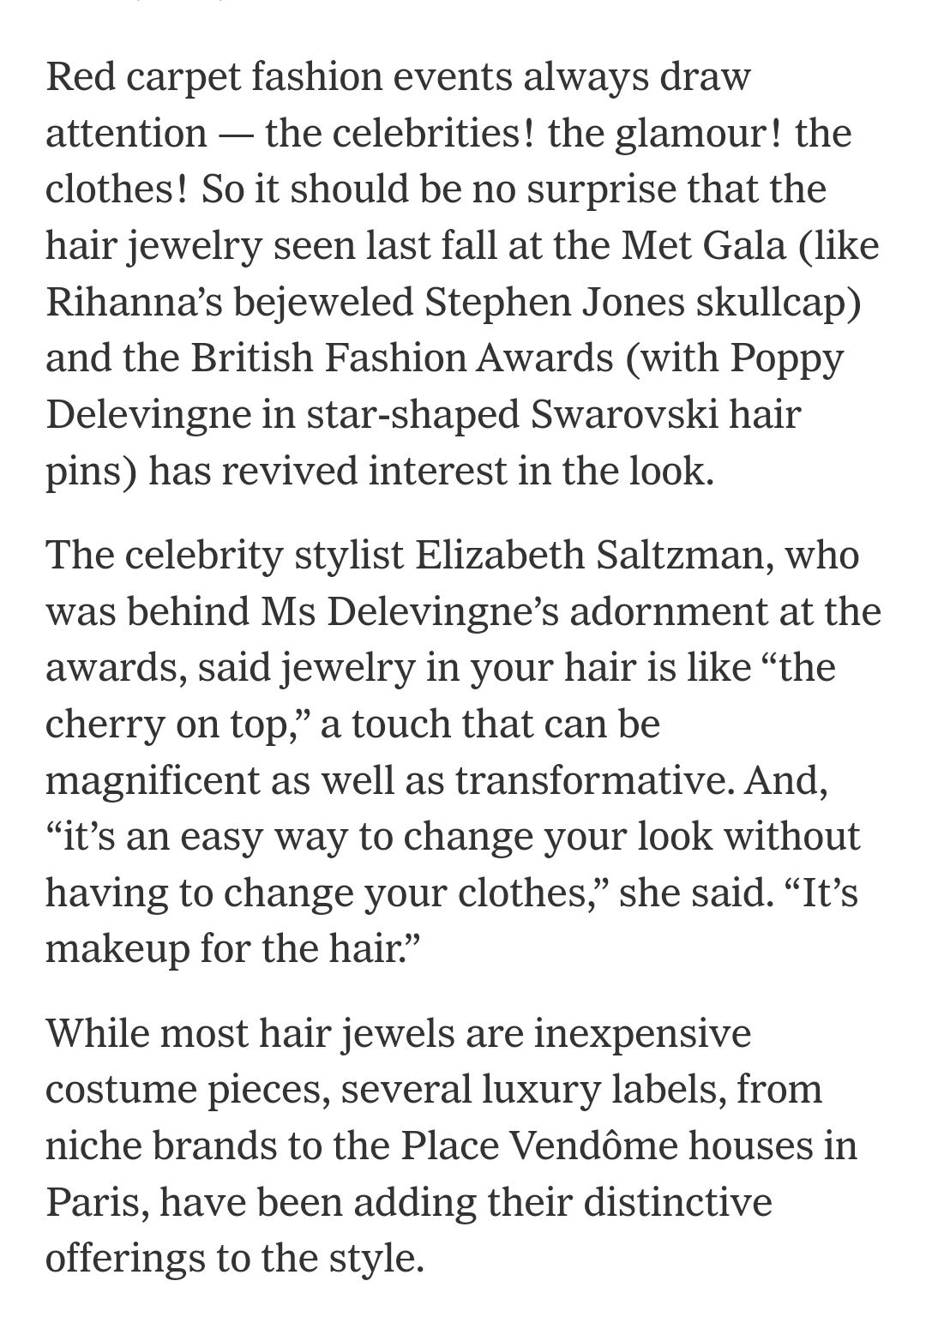
Hair Jewelry Media
Television
Social Media
“…a tennis necklace as hair ornament…”
Mainstream Media
New York Times “Gems Aren’t Just for Your Fingers” – 1/24/22
“As a client, I would prefer to have pieces that can be worn three different ways, not only one.” Hélène Poulit-Duquesne, Boucheron’s chief executive
The celebrity stylist Elizabeth Saltzman, said jewelry in your hair is like “the cherry on top…It’s makeup for the hair.”
© 2022 Studlees – All Rights Reserved. Patent Pending

Slide 12
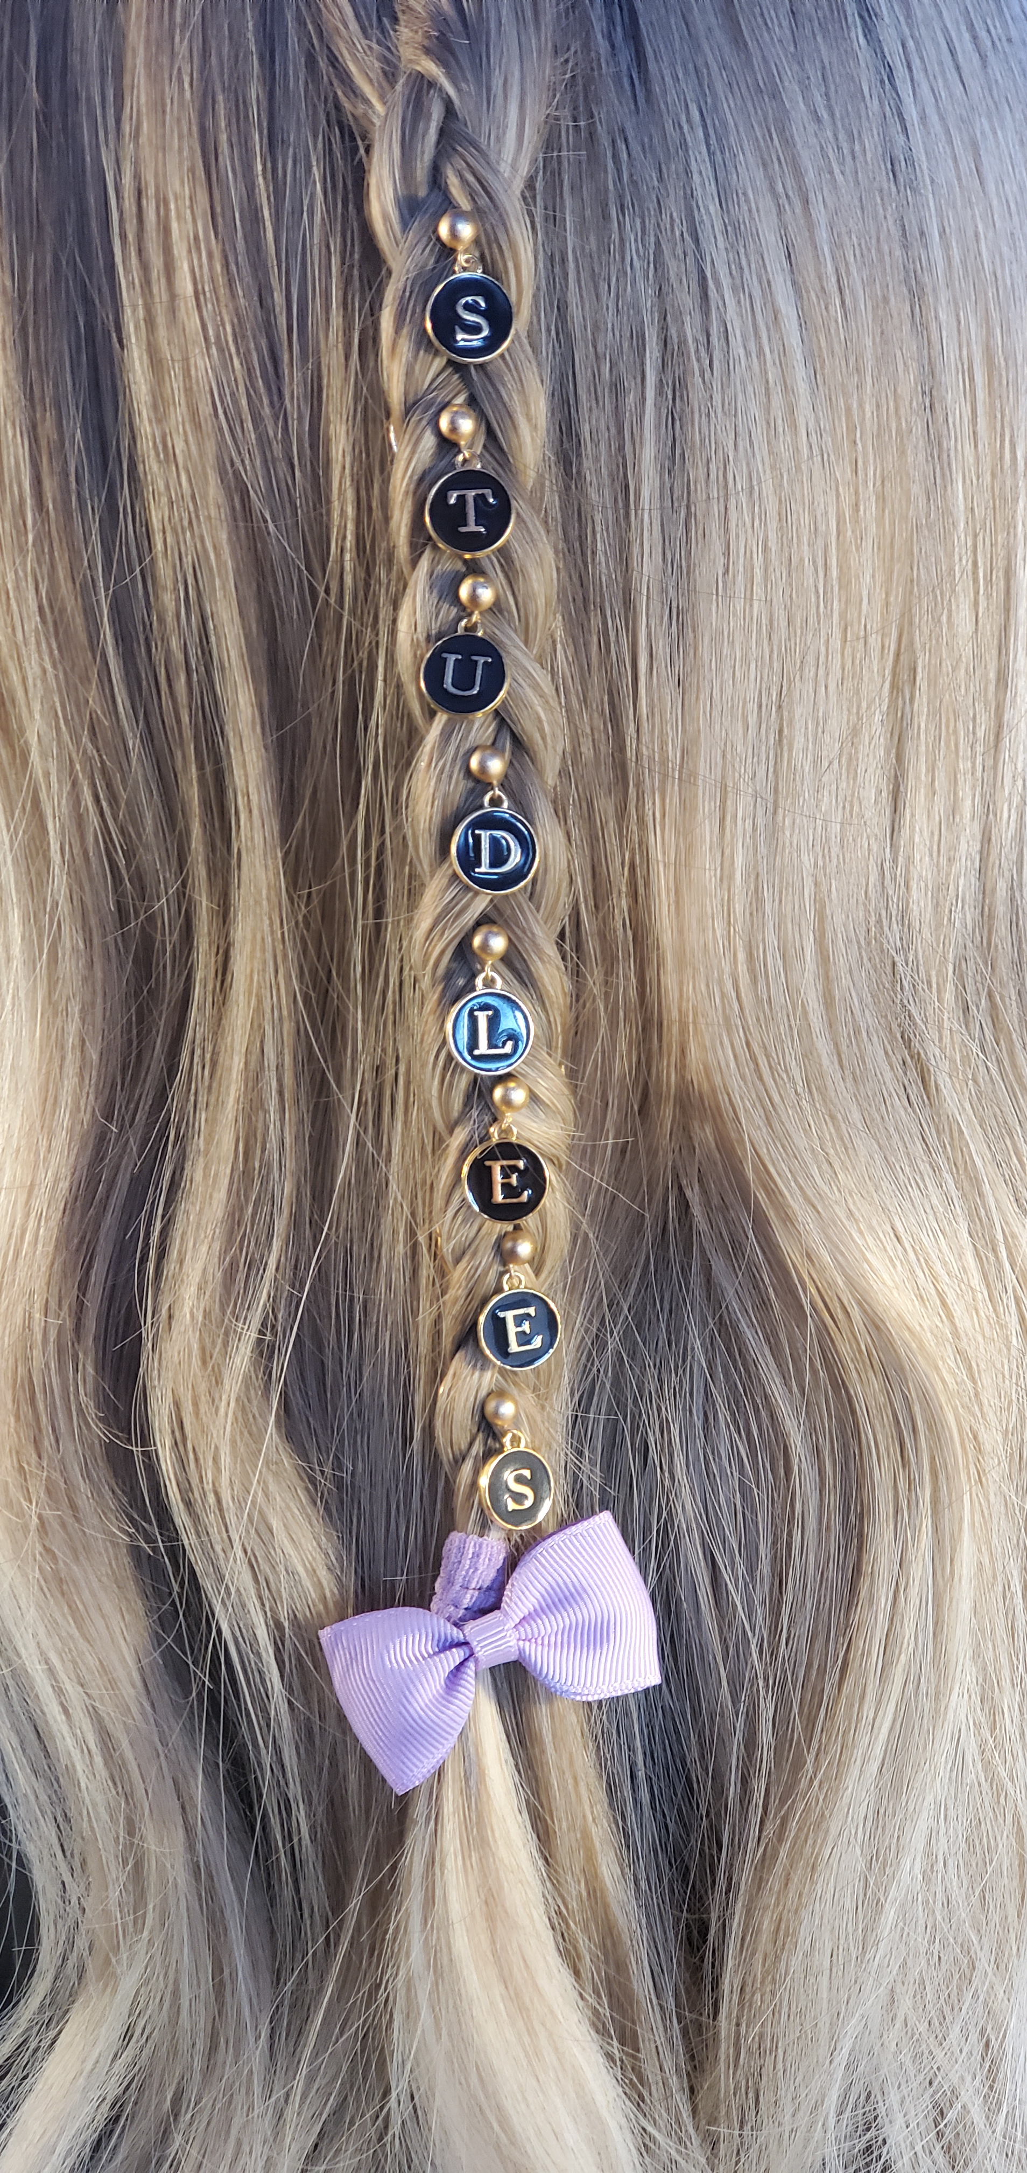
Thank you for your consideration.
Studlees.com
Services@studlees.com
(510) 378-9543

